Slide 1

Bsides Spl²² SmartStore and you!

Slide 2


Hello!
Notes:
Notes about me Gared Seats - Been doing Splunk for 8-9 years ish? Did Splunk PS for several years; seen lots of everything. So there we go. Have you considered leveraging those fancy new cloud technologies to make your Splunk journey a better or more interesting experience? Well you are in luck! This talk will go over one key part of that journey and that is trying to leverage the SmartStore configuration of Splunk Enterprise. We will go into some technical details on how to do a basic setup and what are some things to look out for when you are planning out your current and future storage costs.

Slide 3
Forward Looking Statements
Some or all of the words may or may not be imaginary so, take everything you see or hear today with several grains of salt. Unless you are trying to watch your sodium intake. Then just take everything with a salt substitute. I’ve heard garlic might be good to use
but that’s really up to you. Just keep in mind that any future statements could be completely false.
Just kick back and enjoy the talks and lets hope we all
learn something.

Slide 4

What about this talk?
In the talk
Some Basics on Smart Store and a technical trouble shooting lesson learned about the “quirks” of smartstore.
Not in this talk
Step by step setup of how to setup smart store, or how to properly configure smartstore.

Slide 5

What is Smart Store?
SmartStore is an indexer capability that provides a way to use remote object stores, such as Amazon S3, Google GCS, or Microsoft Azure Blob storage, to store indexed data.
So What?
Notes:
Go over the definition. The So what? Gives the ability to store indexed data on “special” managed cloud storage structures. They are specialized storage. No worry about disk failings, a S3 bucket is the one that I will be going over mostly today since that is what I have experience with.

Slide 6

Some Pluses for Smart Store
Cost
If set appropriatly it can lead to possibly cheaper storage set ups in certain setups.
Fast with proper cache
If setup properly can be used for nice quick searches
Riselency
Since all Warm Buckets are stored on a remote storage; could be higher resiliency compared to trying to replicate “in house”
Notes:
Check SP Sales Pitch

Slide 7
Some basics for Setup
Specify the indexes.conf for remote storage.
[volume:s3volume]
storageType = remote
path = s3://<bucketname>/rest/of/path
remote.s3.endpoint = https://s3.us-west-1.amazonaws.com
Don’t forget authentication and securing/encrypting/ssl the data in the remote store.
Notes:
https://docs.splunk.com/Documentation/Splunk/9.0.1/Indexer/ConfigureremotestoreforSmartStore sslVerifyServerCert
sslAltNameToCheck
sslCommonNameToCheck

Slide 8
One MORE THING…..or several
Each Cluster must have its own remote Volume. (No mulitple clusters using same remote smartstore paths)
repFactor=auto
maxDataSize=auto (750MB)
Bootstrapping is required when brining old data to new indexers. (Old smart store data)
Don’t forget about calculating cache size
Notes:
Note to get old data to smart store.

Slide 9
Add Old Data to new Storage?
1. Setup the new Smartstore with a new indexer(s)
2. Test with an upload of a small sample of data to new indexer (wait for buckets to roll)
3. Once confirmed; stop splunk on original indexers.
4. Put cluster in maintenance and upload all .conf files related to smart store settings
5. Turn CM/indexers back on and remove maintenance mode. 6. ??? 7. Profit.
Notes:
You cannot revert an index to non-SmartStore after you migrate it to SmartStore. Docs have a pretty good step by step on this. Refrain from rebalancing data or removing excess buckets There is a fancy migration

Slide 10
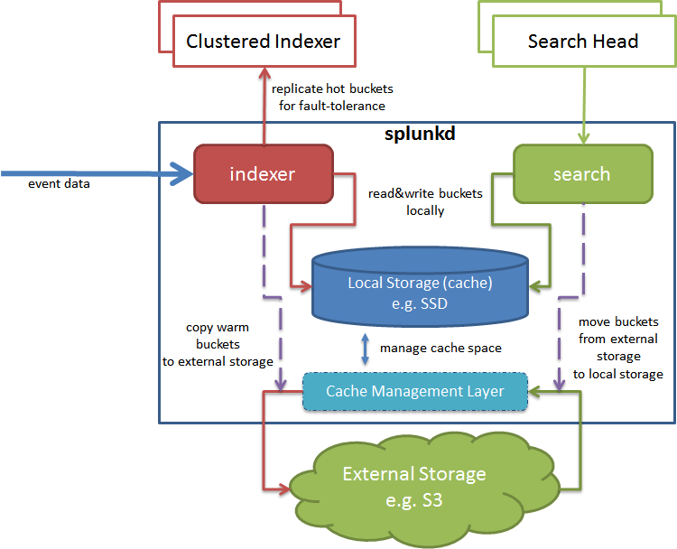
Notes:
Image downloaded from https://docs.splunk.com/images/7/7b/Cache_manager.png
Go over the basics of the diagram and explain the steps; should be a few mins.

Slide 11
A Note about DBINSPECt + Other Tips
Leverage the cached argument carefully.
Manifest is the remote copy of bucket)
Leverage the splunk cmd rfs command
MC Cache Performance Dashboards
Notes:
If the cached argument is set to "t", dbinspect gets its statistics from the bucket's manifest. If set to "f", dbinspect examines the bucket itself.
If =f looks at local cache.
https://docs.splunk.com/Documentation/Splunk/9.0.1/Indexer/TroubleshootSmartStore

Slide 12

SIGN ME UP!
What could possibly go wrong with this?

Slide 13

Some Differences to note
?#^@!
Bucket pathing
No Cold Buckets on Smart Store
Need Cloud? (Or related technology)
Cache on S3
Cannot thaw a frozen bucket to Smart Store. (directly)
Monitoring Console can be filled with “misleading” information for Smart Store
Need Equal SF=RF for SmartStore
Small “buckets”
Notes:
Quote - You cannot thaw an archived bucket into a SmartStore index, even if the bucket, prior to freezing, was part of a SmartStore index. Go into the MC is wrong and why its wrong; spend a few mins going over some thing. Possible talk about DBInspect pending on time…..HA talk about it. Possible Slide to talk about it. The main issue is that that DBInspec does not show full RAW disk size on disk? (compression rate stuff; but that might be a different talk) buckets have to remain small
Not all settings can be used.

Slide 14
So Lets do a quick review of the Buckets between LOCAL vs SmartStore.
LOCAL DISK $SPLUNK_HOME/_internal/db/db_EPOC1_EPOC2_$ID_$GUID
SmartStore Remote bucket {2 letter hash} / {2 letter hash} / {bucket_id_number-origin_guid} / {"guidSplunk"-uploader_guid}/ (bucket contents)
Notes:
Image downloaded from https://www.pngall.com/comic-png/download/59539
Smart Store local stolen from - https://community.splunk.com/t5/Knowledge-Management/smartstore-How-to-map-S2-smartstore-buckets-to-local-splunk/m-p/377770

Slide 15
The Scenario
Notes:
Next Slide will go over the information of it.

Slide 16
An Odd Scenario….
Ticket logged to Splunk Support.
Data Keep “disappearing”
Keeps track of event count of specific files
How do we know?
Notes:
Going to spend of few mins talking over scenarios and steps we took to look into this.

Slide 17
What did we do and learn?
Data was reported as “missing” and we could see it one day; but then out of nowhere it would “disappear”.
Eventually had Devs join support calls and stepped through the way SmartStore buckets worked
A misconfiguration was found to be the culprit.

Slide 18
What did we do and learn? Pt2
Learned about how buckets are named in S3 vs local
Learned that there is a bunch of .dat files in /$SPLUNK_HOME/var/lib/splunk/ are critical in the bucket naming/placement
We did a symlink of $SPLUNK_HOME/var/lib to our ephemeral drive…..oh….
Whoops?

Slide 19
What happened?
Review of SmartStore Remote bucket {2 letter hash} / {2 letter hash} / {bucket_id_number-origin_guid} / {"guidSplunk"-uploader_guid}/ (bucket contents) SO…. S3 Splunk Bucket = _internal~50~$GUID_OF_IDX
Remember the .dat files that I said was important….well….

Slide 20
Root Cause
Symlink to the var/lib location where the indexes .dat files live. Since /opt/ephemeral was wiped out during a shutdown, the .dat files were “reset” back to 0….soooo buckets got overwritten in the S3 store.

Slide 21
Fix
Remove Symlink and instead set the $SPLUNK_DB location instead. This keeps the .dat files on standard EBS; and not on ephemeral with the actual indexed data. (Which can be wiped since the copy lives in S3)

Slide 22
Final Thoughts?
Smart Store is an awesome setup of new ways to store data; but there are still new exciting issues that can be found if not careful

Slide 23


Slide 24

THANKS!

